Slide 1


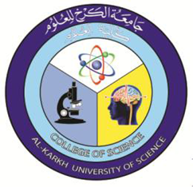
Dr. Hiba Shakir Ahmed
Microbiology / Clinical Immunology

Slide 2
Control of viral infections
Lecture 4

Slide 3
Control of viral infections
Host defenses
Antiviral chemotherapy
vaccinations

Slide 4
2- Interferons (IFNs):
Are host-coded proteins that are members of the large cytokine family and which inhibit viral replication. They are produced very quickly (within hours) in response to viral infection or other inducers and are one of the body's first responders in the defense against viral infection. IFNs are central to the innate antiviral immune response. They also modulate humoral and cellular immunity and have broad cell growth regulatory activities.
Host defenses
Non specific host defenses
1-Anatomic barriers: located either at body surface ( skin and mucus membrane) or within body (endothelial cells).

Slide 5
Mode of action: It appears to involve the induction of host cell enzymes that inhibit viral RNA translation, ultimately leading to the degradation of viral mRNA and tRNA.
IFNs are divided into three types based on the cell of origin:
a- IFN-alpha is produced by leukocytes, it is induced by viruses.
b- IFN-beta is produced by fibroblasts, it is induced by viruses.
c- IFN-gamma is produced by lymphocytes, it is induced by mitogen stimulation.

Slide 6
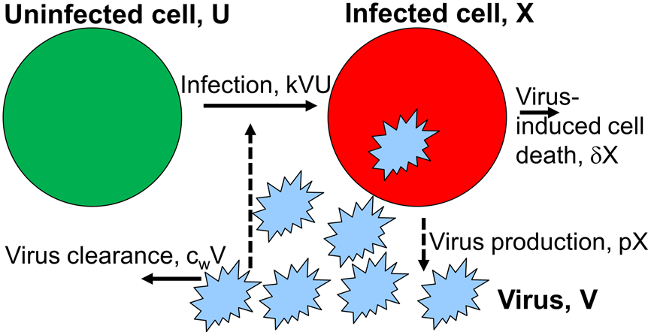

Slide 7
Specific host defenses
1-Produced antibodies and stimulate the cytotoxic T-cell in first exposure to virus .
2-IgM and IgG confer protection against viruses that enter or are spread through the blood
Tow main mechanism for kill the virus by antibodies:
1-nutralization (antigen antibody reaction).
2-lysis of infected cells.
3-NK cells and phagocytosis
NK cells are important parts of the innate defenses against virus infected cells .They kill virus –infected cells by secreting some enzymes ,which causes death of infected cells .
Viruses may be phagocytosis by different PMN leucocytes and macrophages .The effect of phagocytosis may be virus inactivation,and result in clearance of virus

Slide 8
Antiviral Chemotherapy
Unlike viruses, bacteria and protozoans do not rely on host cellular machinery for replication, so processes specific to these organisms provide ideal targets for the development of antibacterial and antiprotozoal drugs. Because viruses are obligate intracellular parasites, antiviral agents must be capable of selectively inhibiting viral functions without damaging the host, making the development of such drugs very difficult. So few drugs are selective enough to prevent viral replication without injury to the host. Antiviral chemotherapy drugs are available to treat a few viral diseases when compared with many antibacterial drugs.

Slide 9
Targets of antiviral drugs :
Antiviral drugs specifically inhibit one or more steps of viral replication, which act as target site for these drugs.
Inhibit early steps of infection; attachment, penetration and uncoating.
Interfere with synthesis of viral mRNA .
Prevent protein synthesis.
Inhibit replication of viral N.A
Inhibit assembly and releasing of mature viral particles from infected cell.

Slide 10
Types of antiviral drugs:
Nucleoside analogues: They target the viral enzymes (thymidine kinase, DNA polymerase, reverse transcriptase) that are involved in the synthesis of viral DNA (replication), they act as chain terminators. The majority of available antiviral agents are nucleoside analogues. Selective toxicity is based on the differences in the ability of the analogue to bind and be utilized by the enzymes used in viral DNA synthesis versus those used in host cell DNA synthesis.
Nucleotide Analogues: It differs from nucleoside analogues in having an attached phosphate group. Their ability to persist in cells for long periods of time increases their potency. Cidofovir is an example.
Nonnucleoside Reverse Transcriptase Inhibitors (NNRTI: Nevirapine was the first member of the class of non nucleoside reverse transcriptase inhibitors. It does not require phosphorylation for activity and does not compete with nucleoside triphosphates. It acts by binding directly to reverse transcriptase and disrupting the enzyme's catalytic site.

Slide 11
4- Nucleoside and nucleotide Reverse Transcriptase Inhibitors (NRTIs): Zalcitabine, Didanosine, Stavudine and Zidovudine, These drugs have similar modes of action and are mostly used in conjunction with other main classes of antiretroviral drugs: NNRTI and Protease Inhibitors to treat HIV-1 infected individuals.
5- Protease Inhibitors: Saquinavir was the first protease inhibitor to be approved for treatment of HIV infection. Such drugs inhibit the viral protease that is required at the late stage of the replicative cycle to cleave the viral polypeptide precursors to form the mature virion core and activate the reverse transcriptase that will be used in the next round of infection. Protease inhibitors include indinavir, nelfinavir and ritonavir .
6- Fusion Inhibitor: Fuzeon is a large peptide that blocks the virus and cellular membrane fusion step involved in entry of HIV-1 into cells

Slide 12


